Slide 1
COMP6115 Object Oriented Analysis and Design Session #2

Slide 2
Project Management

Slide 3
Learning Outcomes
LO1: Identify the basic concept of advance topic in Object Oriented Analysis and Design
LO2 : Use the knowledge to develop documentation for object oriented software analysis and design using Unified Modelling Language

Slide 4
Chapter 2: Project Management

Slide 5
Learning Objectives
Link information systems to business needs
Learn how to create a system request
Understand system feasibility
Learn how to perform a feasibility analysis
Understand how to select a project
Become familiar with work breakdown structure, Gantt charts & network diagrams
Become familiar with use-case driven effort estimation
Learn how to create an interactive project workplan
Learn how to manage the scope, refine estimates and manage the risk of a project
Become familiar with how to staff a project
Learn how the environment and infrastructure workflows interact with the project management workflow

Slide 6
Introduction
Project Management is the process of planning and controlling system development within a specified time at a minimum cost with the right functionality
A project is a set of activities with a specified beginning and end point meant to create a system that brings value to the business
Project Managers monitor and control all tasks and roles that need to be coordinated
Inception phase: generate a system request based on a business need or opportunity
Perform a feasibility analysis; revise the system request
Approve or decline the project

Slide 7
Project Identification
Projects are driven by business needs
Identified by business people
Identified by IT people
(better yet) identified jointly by business and IT
The project sponsor believes in the system and wants to see it succeed
Normally this is a business person
Should have the authority to move it forward

Slide 8
Business Value
Tangible Value
Can be quantified and measured directly
Example: 2 percent reduction in operating costs
Intangible Value
We know it will add value & save time, but we may not be able to quantify or measure its benefits
Example: improved customer service

Slide 9
The System Request
A document that describes the reasons for and the value added from building a new system
Contains 5 elements:
Project sponsor: the primary point of contact for the project
Business need: the reason prompting the project
Business requirements: what the system will do
Business value: how will the organization benefit from the project
Special issues: Anything else that should be considered

Slide 10
Feasibility Analysis
Is this project feasible?
What are the risks?
Can these risks be overcome?
Major components:
Technical feasibility (Can we build it?)
Economic feasibility (Should we build it?)
Organizational feasibility (Will they use it?)

Slide 11
Technical Feasibility
Identify risks in the following areas:
The functional area: Are analysts familiar with this portion of the business?
The technology: Less familiarity generates more risk
Project size: Large projects have more risk
Compatibility: Difficult integration increases the risk

Slide 12
Economic Feasibility (Cost-Benefit Analysis)
Identify the costs and the benefits
Assign values to the costs and benefits
Determine the cash flow
Determine the value using one or more methods:
Net present value (NPV)
Return on investment (ROI)
Break-even point

Slide 13
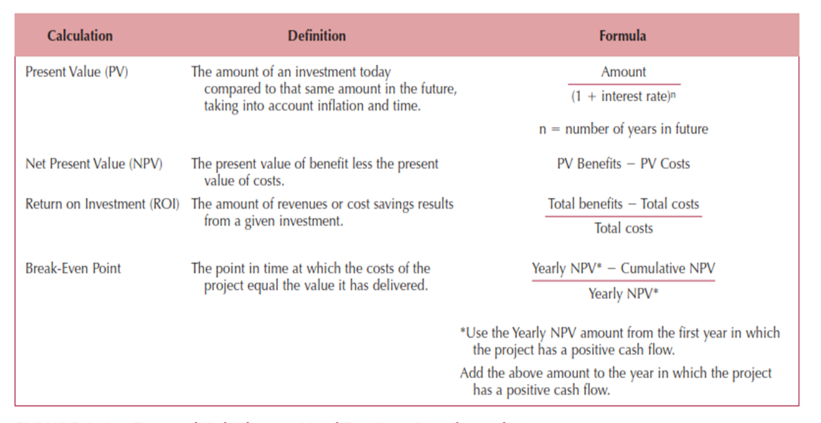
Formulas for Determining Value

Slide 14
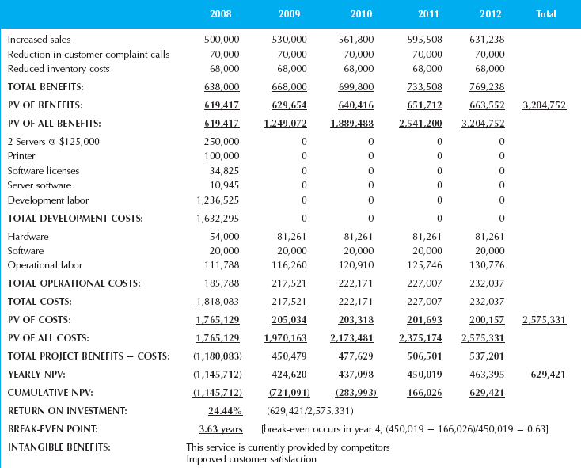
Example Cost-Benefit Analysis

Slide 15
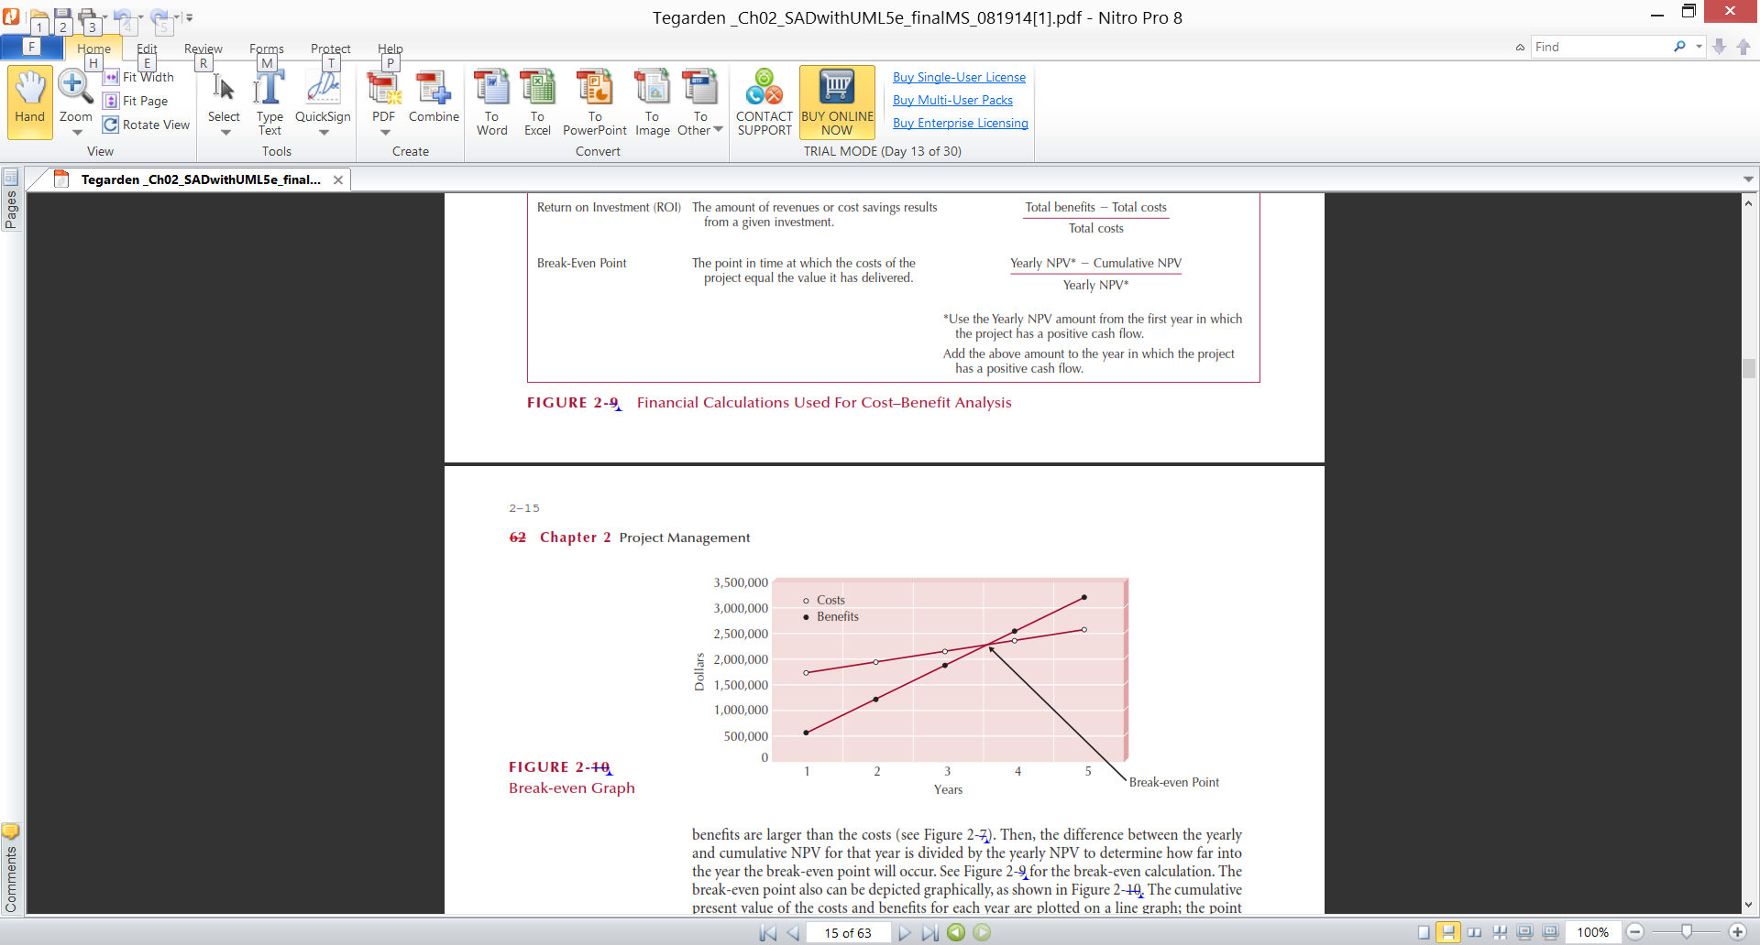
Example Break-Even Point

Slide 16
Organizational Feasibility
Will the users accept the system?
Is the project strategically aligned with the business?
Conduct a stakeholder analysis
Project champion(s)
Organizational management
System users
Others

Slide 17
Project Selection
Projects are approved, declined or delayed based on value added vs. risks
Project portfolio management
Goals:
Maximize cost/benefit ratio
Maintain an optimal mix of projects based on:
Risk
Size, cost & length of time to complete
Purpose, scope & business value
Limited resources require trade-offs
Selected projects enter the project management process

Slide 18
Project Management Tools
Aids in creating workplans
Identify all tasks, their sequence and estimate the time to complete each one
Work breakdown structures (WBS): a hierarchy of tasks to identify:
Duration of each task
Current status of each task
Task dependencies (shows which tasks must be completed before others can begin)
Gantt charts: horizontal bar chart that shows the WBS graphically
Network diagrams: PERT and CPM

Slide 19
Project Effort Estimation
Estimation involves trade-offs between functionality, time and cost
It is the process of assigning projected values for time and effort
Most accurate estimates come from experience
Use-case point method; based on:
Technical complexity factors (13)
Environmental factors (8)

Slide 20
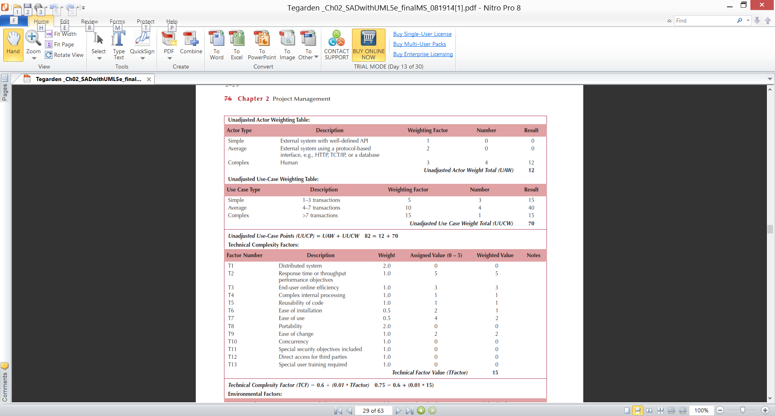
Use-case Estimation Example
Actors & Use-cases:

Slide 21
Use-case Estimation Example
Technical complexity factors:

Slide 22
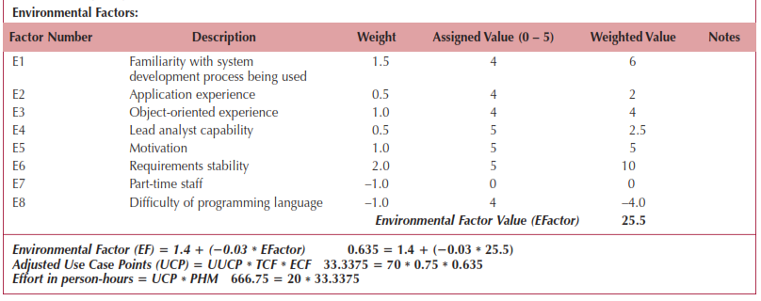
Use-case Estimation Example
Environmental factors & final estimate:

Slide 23
Creating & Managing the Workplan
Workplan: a dynamic and sequential list of all tasks needed to complete a project
Approaches:
Modify existing or completed projects
Derive the tasks from the methodology being used
Unified Process:
Iterative & incremental
Workplan is also iterative & incremental
Tasks and time intervals follow the phases
Different tasks executed for each workflow

Slide 24
Evolutionary Work Breakdown Structures
Organized in a standard manner across all projects
Created in an incremental & iterative manner
Generality supports learning from past mistakes and successes
Unified Process:
Workflows are the major divisions
Workflows are decomposed along the phases
Phases are decomposed along the required tasks
Tasks are added as each iteration is completed

Slide 25
Scope Management
Scope “creep”
Occurs after the project is underway
Results from adding new requirements to the project
Can have a deleterious effect on the schedule
Techniques to manage the project scope:
Identify all requirements at the outset
Allow only those changes deemed absolutely necessary
Carefully examine the impact of suggested changes
Delay some changes for “future enhancements”
Time boxing

Slide 26
Staffing the Project
Goals:
Determine how many people are required
Match skill sets to required activities
Motivate the team to meet the objectives
Minimize conflicts
Deliverable—The staffing plan, which includes:
Number & kind of people assigned
Overall reporting structure
The project charter (describes the project’s objectives and rules)

Slide 27
Creating a “Jelled” Team
A team of people so strongly knit that the whole is greater than the sum of its parts
Characteristics of a jelled team:
Very low turnover rate
Strong sense of identity
A feeling of eliteness
Team vs. individual ownership of the project
Team members enjoy their work

Slide 28

The Staffing Plan
Calculate the number of people needed:
Lines of communication increase exponentially as people are added to a project
Create a reporting structure for projects with large numbers of people assigned
Form sub-teams as necessary
Assign the Project Manager, Functional lead & Technical lead
Pay attention to technical and interpersonal skills

Slide 29
Motivating People
Motivation is the greatest influence on performance
Monetary rewards usually do not motivate
Suggested motivating techniques:
20% time rule
Peer-to-peer recognition awards
Team ownership (refer to the team as “we”)
Allow members to focus on what interests them
Utilize equitable compensation
Encourage group ownership
Provide for autonomy, but trust the team to deliver

Slide 30
Handling Conflict
Preventing or mitigating conflict:
Cohesiveness has the greatest effect
Clearly defining roles and holding team members accountable
Establish work & communications rules in the project charter
Additional techniques:
Clearly define plans for the project
Make sure the team understands the importance of the project
Develop detailed operating procedures
Develop a project charter
Develop a schedule of commitments in advance
Forecast other priorities and their impact on the project

Slide 31
Environment & Infrastructure Management
Environment—Choose the right set of tools
Use appropriate CASE tools to:
Increase productivity and centralize information (repository)
Utilize diagrams—more easily understood
Establish standards to reduce complexity
Infrastructure—Document the project appropriately
Store deliverables & communications in a project binder
Use Unified Process standard documents
Don’t put off documentation to the last minute

Slide 32
Summary
Project Initiation
Feasibility Analysis
Project Selection
Traditional Project Management Tools
Estimating Project Effort
Create and manage the workplan
Staff the project
Manage the environment and infrastructure work flows of the project

Slide 33
References
Denis, Wixom,Tegarden. (2015). Systems Analysis and Design: An Object-Oriented Approach with UML. 5th edition. ISBN: 978-1-118-80467-4, John Wiley & Sons, Inc, Denver (USA)

